Slide 1
Popular Easter Traditions in Poland
By
Kinga Matracka, Julia Półtorak, Michalina Semków, Maja Zarzycka,
Magda Spyra

Slide 2
Food Blessing / Swieconka
Swieconka is one of the most enduring and beloved Polish traditions. On Saturday before Easter people take to churches decorated baskets containing a sampling of traditional food to be blessed: hard-boiled shelled eggs, ham, sausage, salt, horseradish, fruits, bread and cake. Prominently displayed among these is the Easter lamb, usually molded from butter or sugar and colorful pisanki (coloured eggs). The food has a symbolic meaning, for example:
* eggs - symbolize life and Christ's resurrection,
* bread - symbol of Jesus,
* lamb - represents Christ,
* salt - represents purification,
* horseradish - symbolic of the bitter sacrifice of Christ,
* ham - symbolic of great joy and abundance.
The food blessed in the church remains untouched until Sunday morning.

Slide 3
Writing eggs/
Pisanki, kraszanki. malowanki, drapanki, wyklejanki, nalepianki

Slide 4
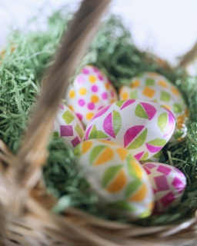
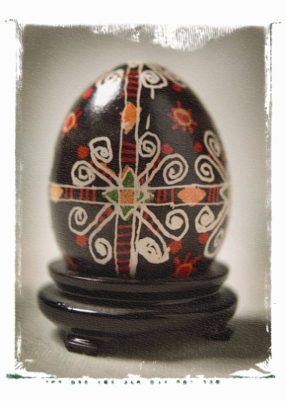
The custom of coloring eggs for Easter is still observed in Polish custom. The eggs are decorated with many traditional Polish symbols of Easter. Most popular are lamb, cross, floral designs or Easter's greetings such as Wesollego Alleluja.
According to the Polish folk craft experts we divide Written
Eggs to different categories. The eggs decorated with the
use of treated wax are called "pisanki". Another technique involved gluing colored paper or shiny fabric on them. The eggs which are painted in one color are called "malowanki" or "kraszanki". If patterns are etched with a pointed instrument on top of the paint, the eggs are then called "skrobanki" or "rysowanki".

Slide 5
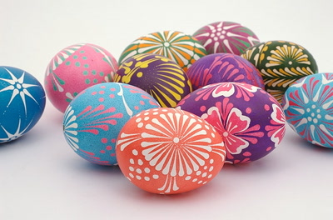
Easter eggs
Easter eggs are eggs (usually chicken, but also the goose or duck) decorated with various techniques. Before they believed that given eggs at Easter were protecting from the evil and an auspiciousness, a health and a luck in love guarantee.

Slide 6
Eggshells are being decorated with various methods in various regions of Poland. Depending on the technique of decorating, festive eggs have different names.
We can decorate them, for example :
with drawing on hot, molten wax
with multicolored cut-outs of paper
throwing them into ready or done dye
scraping patterns with the special knife

Slide 7
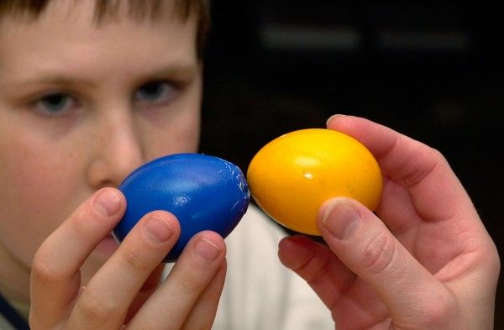
At present painted eggs are being carried out before the Easter. And now the ceremonial breakfast on Sunday Easter is preceding sharing by the blessed egg.

Slide 8

EASTER FOOD
What can you find in an Easter basket?

Slide 9
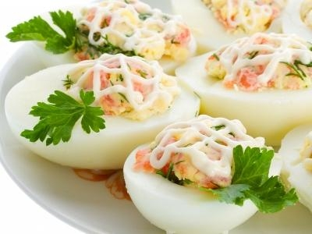
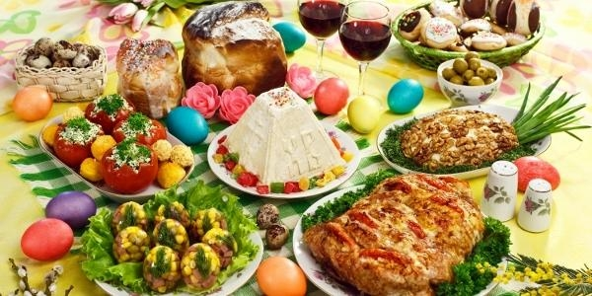
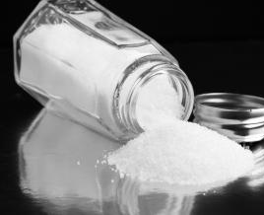
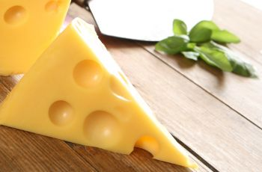
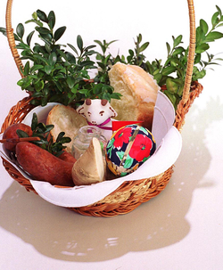
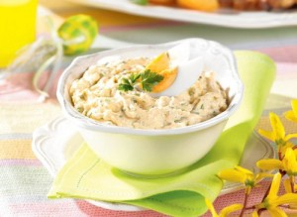
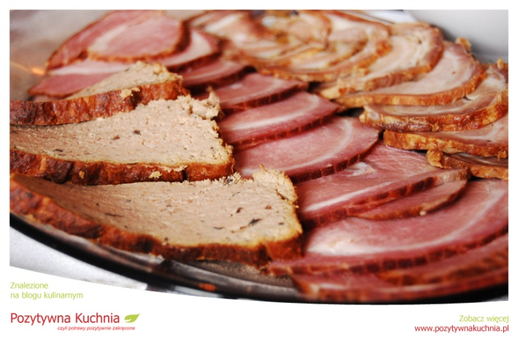

Slide 10
EGG- symbol of reviving life, victory over death. It was the egg begins dividing the Easter breakfast, which connects to the wishes of joy, health, happiness in family life, and - according to a tradition - fertility.
SALT-formerly owned deterrent power of all evil. Symbolizes cleansing, the core of existence and truth.
SAUSAGE- assured fertility and abundance.
CHESSE-is a symbol of friendship between man and the forces of nature, is a guarantee of the development of the household, especially when it comes to animal husbandry.
HORSERADISH- only yourself beaten, in the folk tradition was a symbol of all the strength.
CAKE- (the home) is a symbol of skill and excellence.

Slide 11
Easter Sunday /
Wielka Niedziela

Slide 12
On Easter morning, a special Resurrection Mass is celebrated in every church in Poland. At this Mass, a procession of priests, altar boys and the people circles the church three times while the church bells peal and the organ is played for the first time since they had been silenced on Good Friday. Following the Mass, people return home to eat the food blessed the day before.
The Easter table will be covered with a white tablecloth. The white tablecloth is indicative of the white swaddling cloth with which Our Lord was wrapped when he was placed in the Holy Sepulcher. On the middle of the table in most homes housewife put colored eggs, cold meats, coils of sausages, ham, yeast cakes, pound cakes, poppy-seed cakes, and a lamb made of sugar. Polish Easter Soup called Zurek or White Barszcz is often served at the Easter meal, garnished with the hard-boiled eggs and sausage. There is also tradition to share blessed eggs with the members of the family and wish each other good health, happiness for the rest of the year.

Slide 13
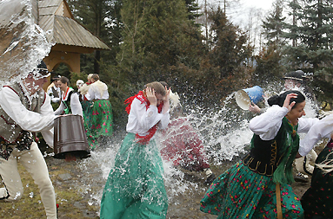
EASTER MONDAY

Slide 14
What is the easter Monday?
Easter Monday is the first Monday after Easter. It is not only Polish tradition. It's also celebrated in Slovakia and the Czech Republic. On this day people throw water at each other, mostly in the morning. So don't get scared if you will wake up all wet. Young people at old, old at young, priests at nuns, mothers at fathers, brothers at sisters, etc. Especially young people like it. It's a good tradition if people don't throw too much water at each other!

Slide 15
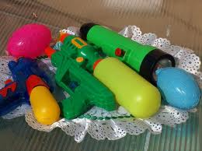
What is the most useful:

Slide 16
Happy Easter!

